Slide 1
Introduction to
Neural Networks

Slide 2
Neural Network
This series of lectures will cover key theory aspects:
Neurons and Activation Functions
Cost Functions
Gradient Descent
Backpropagation

Slide 3
Neural Network
Once we build a general high level understanding we will code out all these topics manually with Python, without the use of a deep learning library.
Then we can move on to using TensorFlow!

Slide 4
Neural Network
Understanding a high level overview of these key elements will make it much easier to understand what is happening when we begin to use TensorFlow!
Tensorflow has direct connections to these concepts in its syntax!

Slide 5
Let’s get started!

Slide 6
Introduction to
the Perceptron

Slide 7
Perceptron
Before we launch straight into neural networks, we need to understand the individual components first, such as a single “neuron”.

Slide 8
Perceptron
Artificial Neural Networks (ANN) actually have a basis in biology!
Let’s see how we can attempt to mimic biological neurons with an artificial neuron, known as a perceptron!

Slide 9
Perceptron
The biological neuron:
Dendrites
Body
Axon

Slide 10
Perceptron
The artificial neuron also has inputs and outputs!
Input 0
Output
Input 1

Slide 11
Perceptron
This simple model is known as a perceptron.
Input 0
Output
Input 1

Slide 12
Perceptron
Simple example of how it can work.
Input 0
Output
Input 1

Slide 13
Perceptron
We have two inputs and an output
Input 0
Output
Input 1

Slide 14
Perceptron
Inputs will be values of features
12
Input 0
Output
4
Input 1

Slide 15
Perceptron
Inputs are multiplied by a weight
12
Weight 0
Input 0
Output
Weight 1
4
Input 1

Slide 16
Perceptron
Weights initially start off as random
12
Weight 0
Input 0
Output
Weight 1
4
Input 1

Slide 17
Perceptron
Weights initially start off as random
12
Input 0
0.5
Output
-1
4
Input 1

Slide 18
Perceptron
Inputs are now multiplied by weights
12
Input 0
0.5
Output
-1
4
Input 1

Slide 19
Perceptron
Inputs are now multiplied by weights
Input 0
12 * 0.5 = 6
Output
4 * -1 = -4
Input 1

Slide 20
Perceptron
Then these results are passed to an activation function.
Input 0
12 * 0.5 = 6
Activation
Function
Output
4 * -1 = -4
Input 1

Slide 21
Perceptron
Many activation functions to choose from, we’ll cover this in more detail later!
Input 0
12 * 0.5 = 6
Activation
Function
Output
4 * -1 = -4
Input 1

Slide 22
Perceptron
For now our activation function will be very simple...
Input 0
12 * 0.5 = 6
Activation
Function
Output
4 * -1 = -4
Input 1

Slide 23
Perceptron
If sum of inputs is positive return 1, if sum is negative output 0.
Input 0
12 * 0.5 = 6
Activation
Function
Output
4 * -1 = -4
Input 1

Slide 24
Perceptron
In this case 6-4=2 so the activation function returns 1.
Input 0
12 * 0.5 = 6
Activation
Function
1
Output
4 * -1 = -4
Input 1

Slide 25
Perceptron
There is a possible issue. What if the original inputs started off as zero?
Input 0
12 * 0.5 = 6
Activation
Function
1
Output
4 * -1 = -4
Input 1

Slide 26
Perceptron
Then any weight multiplied by the input would still result in zero!
Input 0
12 * 0.5 = 6
Activation
Function
1
Output
4 * -1 = -4
Input 1

Slide 27
Perceptron
We fix this by adding in a bias term, in this case we choose 1.
Input 0
12 * 0.5 = 6
Activation
Function
1
4 * -1 = -4
Output
Input 1
+ 1
Bias

Slide 28
Perceptron
So what does this look like mathematically?
Input 0
12 * 0.5 = 6
Activation
Function
1
4 * -1 = -4
Output
Input 1
+ 1
Bias

Slide 29
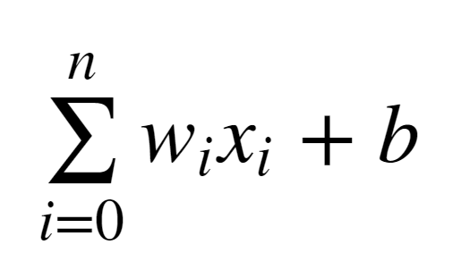
Perceptron
Let’s quickly think about how we can represent this perceptron model mathematically:

Slide 30
Perceptron
Once we have many perceptrons in a network we’ll see how we can easily extend this to a matrix form!

Slide 31
Perceptron
Review
Biological Neuron
Perceptron Model
Mathematical Representation

Slide 32
Introduction to
Neural Networks

Slide 33
We’ve seen how a single perceptron behaves, now let’s expand this concept to the idea of a neural network!
Let’s see how to connect many perceptrons together and then how to represent this mathematically!

Slide 34
Multiple Perceptrons Network

Slide 35
Input Layer. 2 hidden layers. Output Layer

Slide 36
Input Layers
Real values from the data
Hidden Layers
Layers in between input and output
3 or more layers is “deep network”
Output Layer
Final estimate of the output

Slide 37
As you go forwards through more layers, the level of abstraction increases.
Let’s now discuss the activation function in a little more detail!

Slide 38
Previously our activation function was just a simple function that output 0 or 1.
1
Output
0
0
z = wx + b

Slide 39
This is a pretty dramatic function, since small changes aren’t reflected.
1
Output
0
0
z = wx + b

Slide 40
It would be nice if we could have a more dynamic function, for example the red line!
1
Output
0
0
z = wx + b

Slide 41
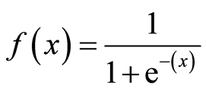
Lucky for us, this is the sigmoid function!
1
Output
0
0
z = wx + b

Slide 42
Changing the activation function used can be beneficial depending on the task!
1
Output
0
0
z = wx + b

Slide 43
Let’s discuss a few more activation functions that we’ll encounter!
1
Output
0
0
z = wx + b

Slide 44
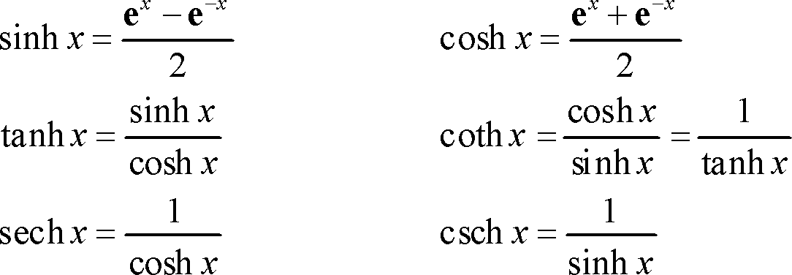
Hyperbolic Tangent: tanh(z)
1
Output
-1
0
z = wx + b

Slide 45
Rectified Linear Unit (ReLU): This is actually a relatively simple function: max(0,z)
Output
0
z = wx + b

Slide 46
Perceptron
ReLu and tanh tend to have the best performance, so we will focus on these two.
Deep Learning libraries have these built in for us, so we don’t need to worry about having to implement them manually!

Slide 47
As we continue on, we’ll also talk about some more state of the art activation functions.
Up next, we’ll discuss cost functions, which will allow us to measure how well these neurons are performing!

Slide 48
Cost Functions

Slide 49
Let’s now explore how we can evaluate performance of a neuron!
We can use a cost function to measure how far off we are from the expected value.

Slide 50
We’ll use the following variables:
y to represent the true value
a to represent neuron’s prediction
In terms of weights and bias:
w*x + b = z
Pass z into activation function
σ(z) = a

Slide 51
Quadratic Cost
C = Σ(y-a)² / n
We can see that larger errors are more prominent due to the squaring.
Unfortunately this calculation can cause a slowdown in our learning speed.

Slide 52
Cross Entropy
C = (-1/n) Σ (y⋅ln(a) + (1-y)⋅ln(1-a)
This cost function allows for faster learning.
The larger the difference, the faster the neuron can learn.

Slide 53
We now have 2 key aspects of learning with neural networks, the neurons with their activation function and the cost function.
We’re still missing a key step, actually “learning”!

Slide 54
We need to figure out how we can use our neurons and the measurement of error (our cost function) and then attempt to correct our prediction, in other words, “learn”!

Slide 55
In the next lecture we’ll briefly cover how we can do this with Gradient Descent!

Slide 56
Gradient Descent
and Backpropagation

Slide 57
If you’ve dabbled in machine learning before, you may have already heard of Gradient Descent!
Let’s quickly go over it with a high level overview!

Slide 58
Gradient descent is an optimization algorithm for finding the minimum of a function.
To find a local minimum, we take steps proportional to the negative of the gradient.

Slide 59
Gradient Descent (in 1 dimension)
C
w

Slide 60
Gradient Descent (in 1 dimension)
C
w

Slide 61
Gradient Descent (in 1 dimension)
C
w

Slide 62
Gradient Descent (in 1 dimension)
C
w

Slide 63
Visually we can see what parameter value to choose to minimize our Cost!
C
w

Slide 64
Finding this minimum is simple for 1 dimension, but our cases will have many more parameters, meaning we’ll need to use the built-in linear algebra that our Deep Learning library will provide!

Slide 65
Using gradient descent we can figure out the best parameters for minimizing our cost, for example, finding the best values for the weights of the neuron inputs.

Slide 66
We now just have one issue to solve, how can we quickly adjust the optimal parameters or weights across our entire network?
This is where backpropagation comes in!

Slide 67
Backpropagation is used to calculate the error contribution of each neuron after a batch of data is processed.
It relies heavily on the chain rule to go back through the network and calculate these errors.

Slide 68
Backpropagation works by calculating the error at the output and then distributes back through the network layers.
It requires a known desired output for each input value (supervised learning).

Slide 69
The implementation of backpropagation will be further clarified when we dive into the math example!
For now let’s finish off our high level discussion with TensorFlow’s playground!

Slide 70
TensorFlow Playground

Slide 71
Go to:
playground.tensorflow.org

Slide 72
Types of Networks

Slide 73
Let’s discuss high level overviews of the various types of neural networks
Dense Networks
Convolutional Networks-CNN
Recurrent Neural Networks-RNN
Generative Adversarial Networks-GAN

Slide 74
Dense Networks

Slide 75
Convolutional Neural Networks

Slide 76
Recurrent Neural Networks

Slide 77
Generative Adverserial Neural Networks

Slide 78
Manual Neural Network
Part 2 - Operation

Slide 79
Operation Class
Input Nodes
Output Nodes
Global Default Graph Variable
Compute
Overwritten by extended classes

Slide 80
Graph - A global variable
Constant
n1
1
Constant
Operation
2
n2
n3

Slide 81
Graph
Constant
n1
1
Constant
Add(Operation)
2
n2
n3
3

Slide 82
Graph
Constant
n1
1
Constant
Multiply(Operation)
2
n2
n3
2

Slide 83
Manual Neural Network
Variables,Placeholders, and Graphs

Slide 84
Placeholder - An “empty” node that needs a value to be provided to compute output.
Variables - Changeable parameter of Graph
Graph - Global Variable connecting variables and placeholders to operations.

Slide 85
Let’s get started!

Slide 86
Manual Neural Network
Session

Slide 87
Now that the Graph has all the nodes, we need to execute all the operations within a Session.
We’ll use a PostOrder Tree Traversal to make sure we execute the nodes in the correct order.

Slide 88
Manual Neural Network
Classification

Slide 89
y = mx + b
y = -1x + 5
Remember that both y and x are features!
Feat2 = -1*Feat1 + 5
Feat2 + Feat1 - 5 = 0
FeatMatrix[ 1, 1] - 5 = 0

